Slide 1
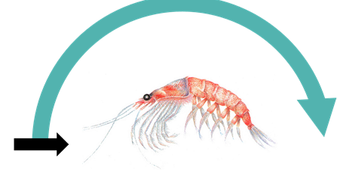
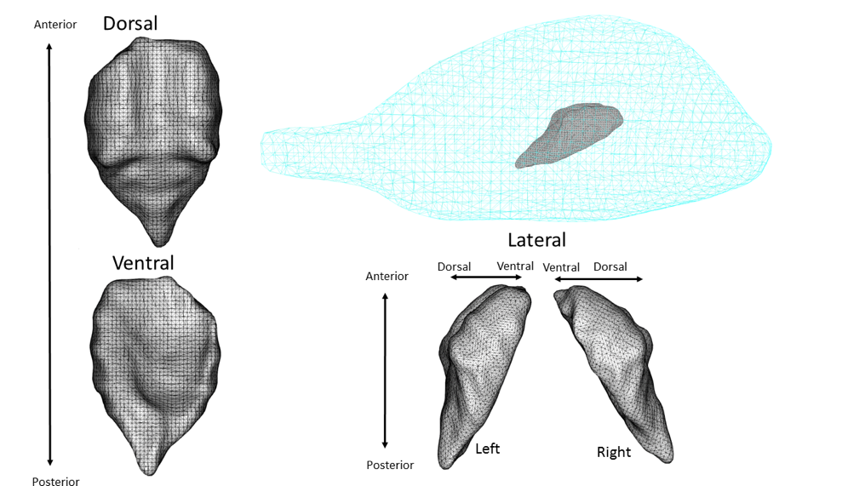
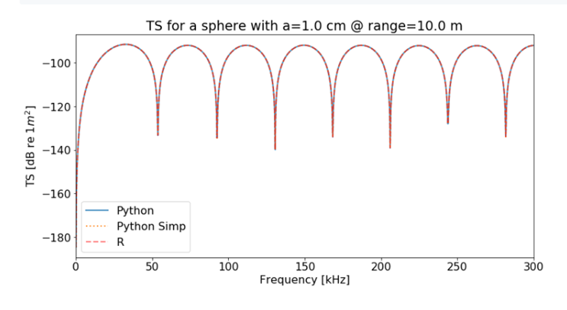
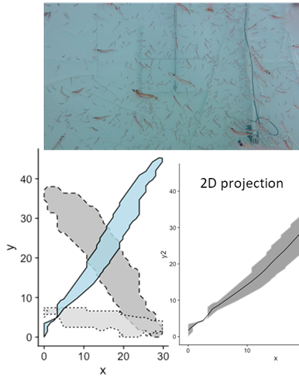
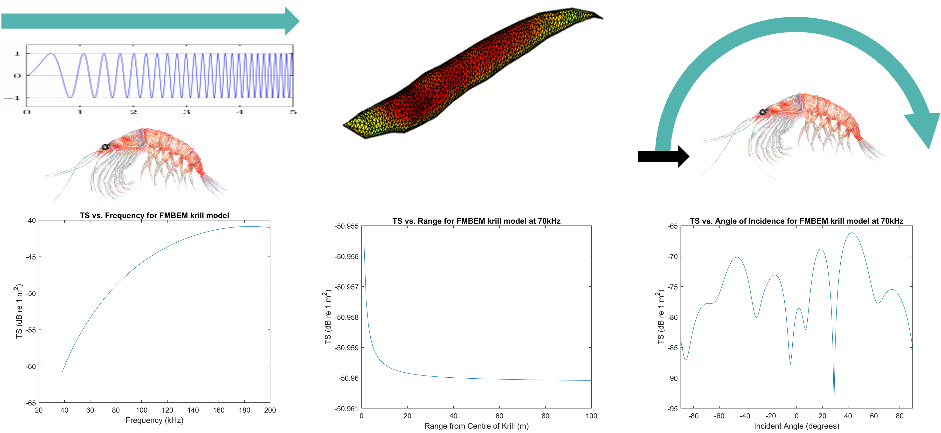
Scattering models in fisheries acoustics
Sven Gastauer, 2020
Scipps Institution of Oceanography, University of California San Diego
sgastauer@ucsd.edu

Slide 2
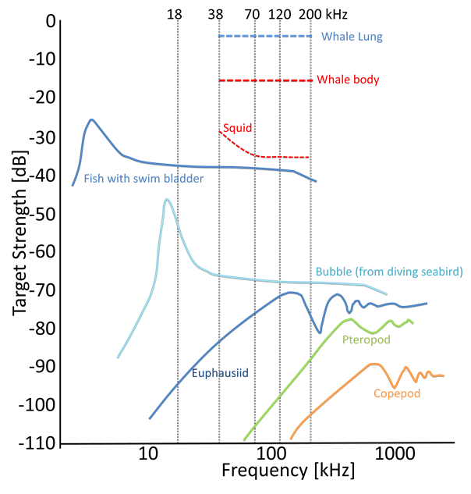
What will we discuss?
Why use scattering models?
What are the main contributors to the scattering?
What models are commonly used?
How to get model input parameters?
How to use ZooscatR for model simulations
How to exploit scattering properties to get size estimates of fish?

Slide 3
Why and what to model?

Slide 4
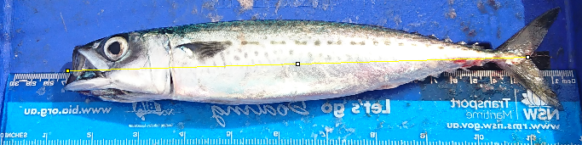
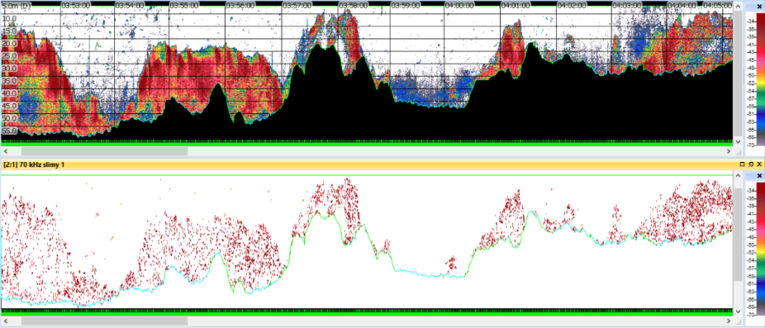
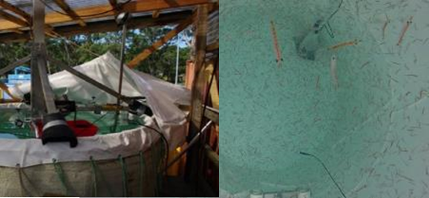
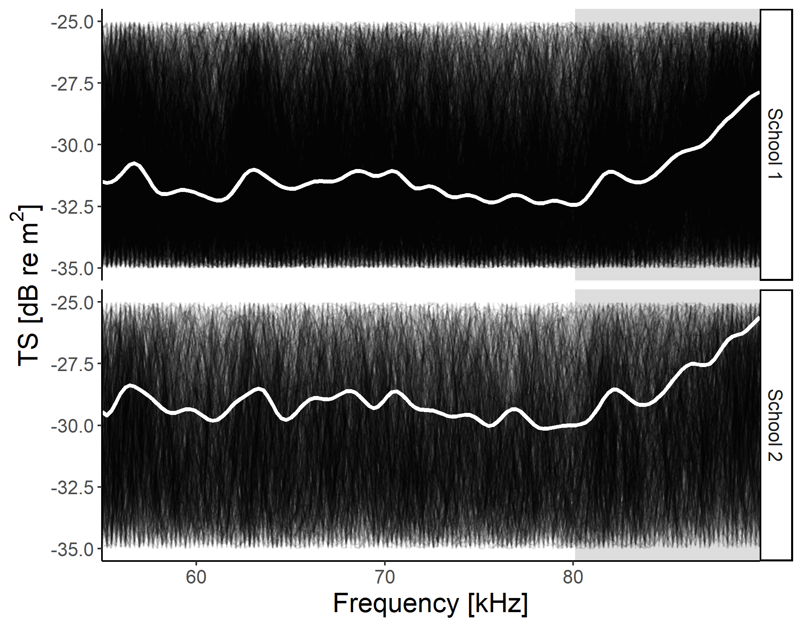
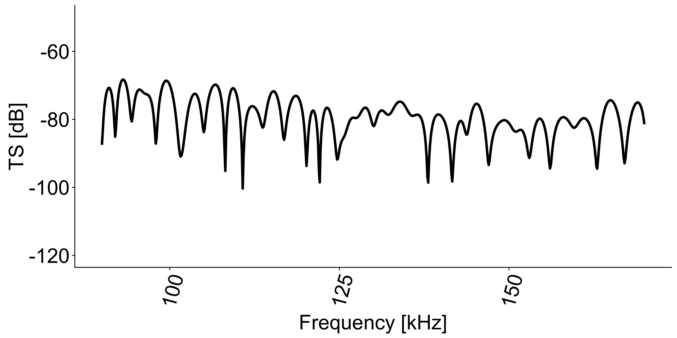
What a mess!
Can we make some sense out of this?

Slide 5
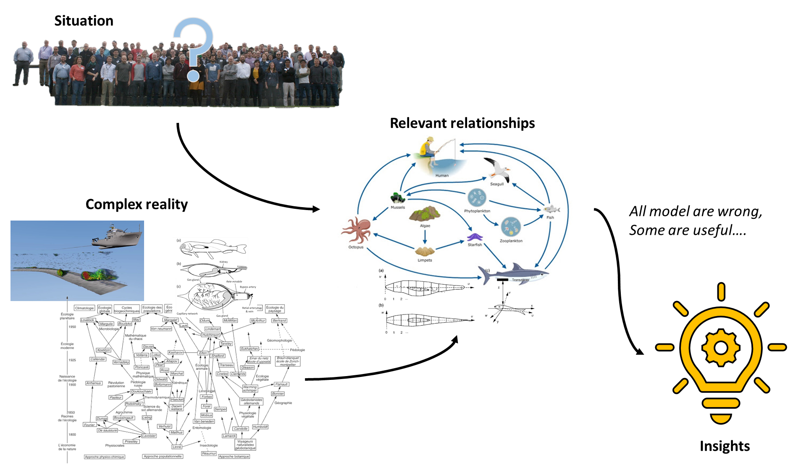

Slide 6
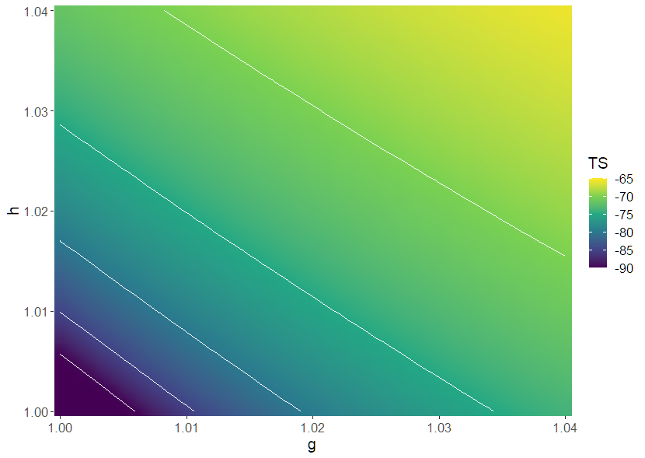
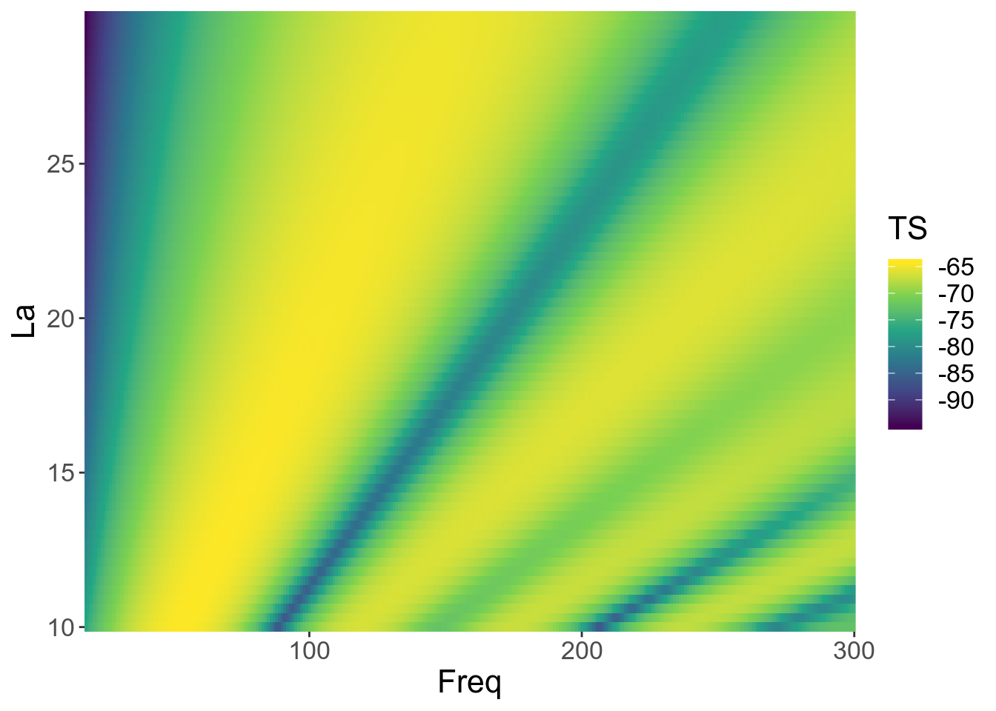
What are main contributors to the scattering?
Main factors influencing target strength:
Echosounder properties -> Frequency
Material properties -> Acoustic impedance, dictated by the density and sound speed contrast
Behaviour -> Orientation (incident angle) of the target
Morphology and Physiology -> Size and shape of the target
Varying g and h
Varying L/a (fatness)

Slide 7
Demonstration Calibration Sphere in R

Slide 8
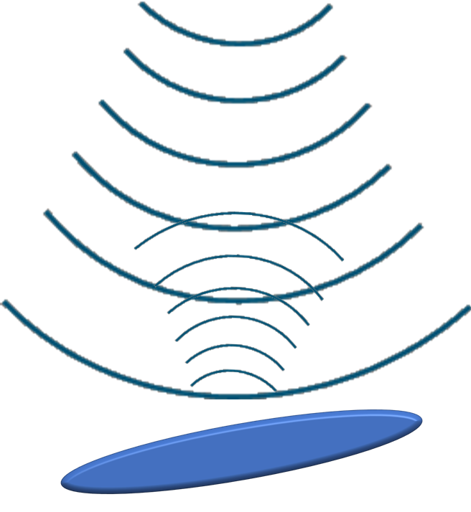
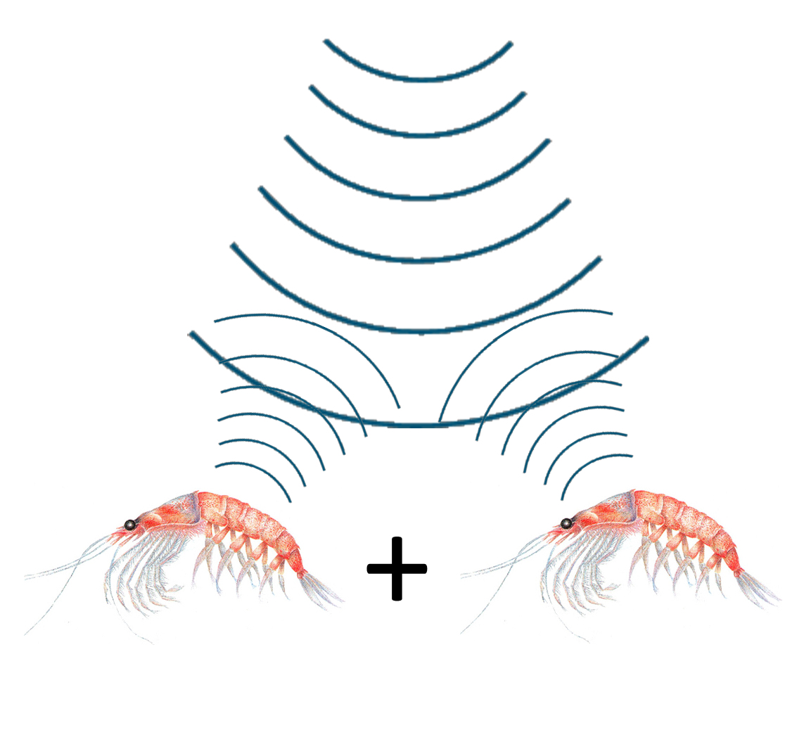
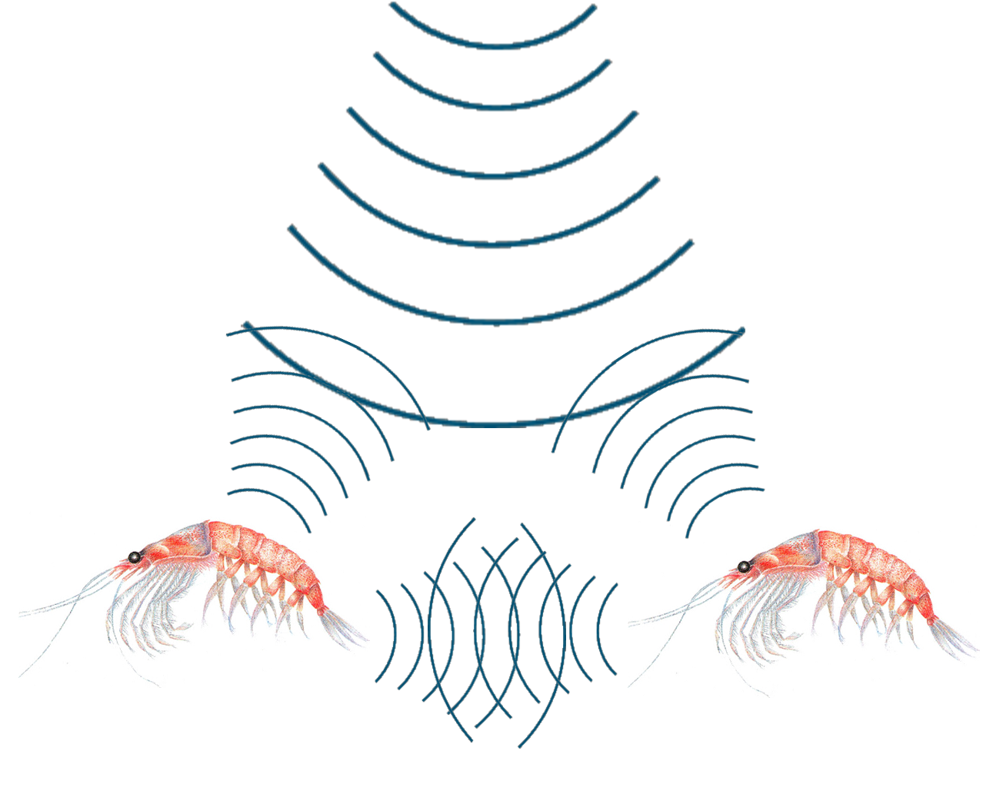
Analytic/semi-analytic models
for simple geometric shapes (e.g. spheres, prolate spheroid,…).
Advantages:
exact
Some are fast
Some are not restricted in frequency/material properties
Disadvantages:
cannot model realistic objects
assume a single scattering object
Can be slow and restrictive in terms of material properties and frequencies
Approximate models
Kirchhoff Ray, Distorted Wave Born Approximation, DCM,…
Advantages:
arbitrary scattering surface & orientation
can be (very) fast & simple
Disadvantages:
model specific restrictions to frequency and material properties range validity
excludes diffraction effects or internal structure
multi-body scattering is additive
Numerical models
Finite/Boundary Element Methods,…
Advantages:
arbitrary shapes/internal structures,
include diffraction/FSI
arbitrary materials and frequencies
include interaction effects between multiple bodies
Disadvantages:
computationally expensive and complex models
Three major categories of scattering models

Slide 9
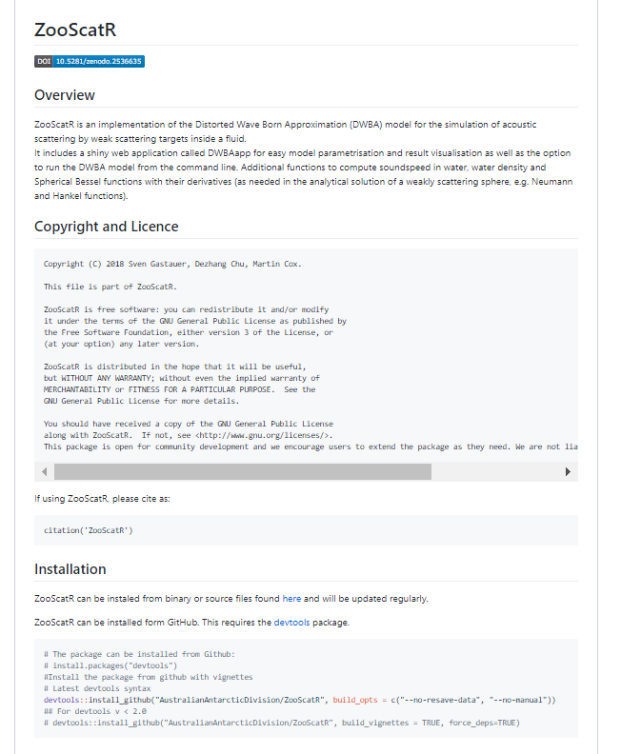
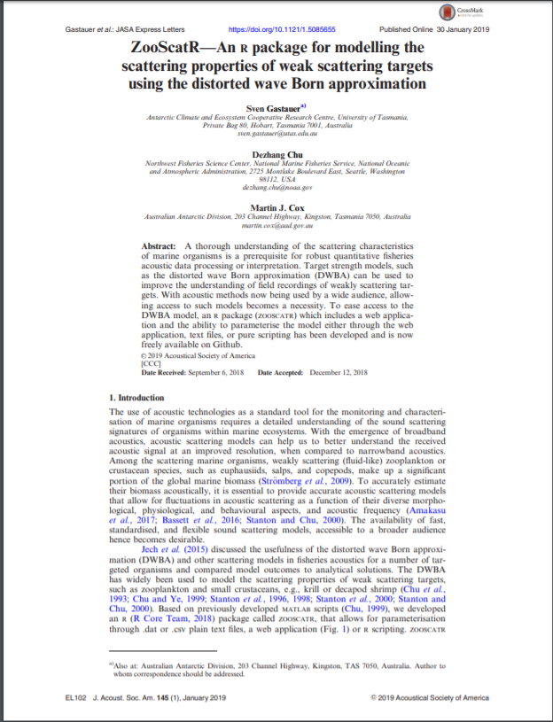
https://github.com/AustralianAntarcticDivision/ZooScatR

Slide 10
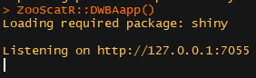
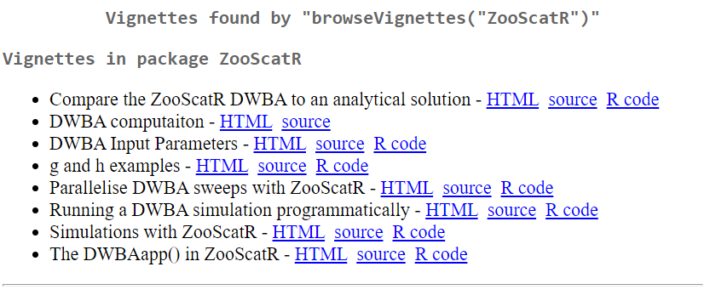
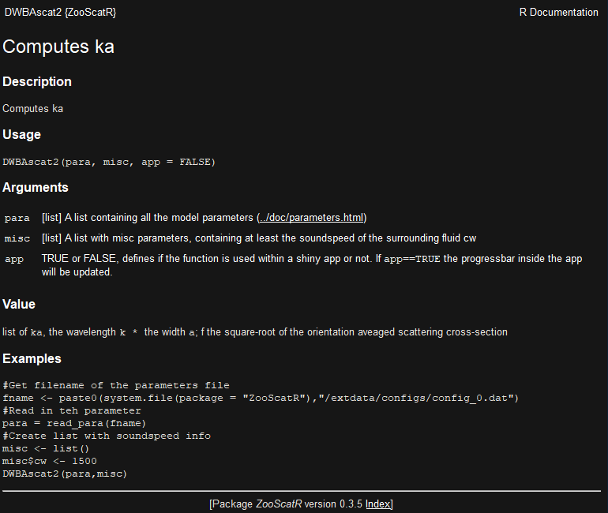
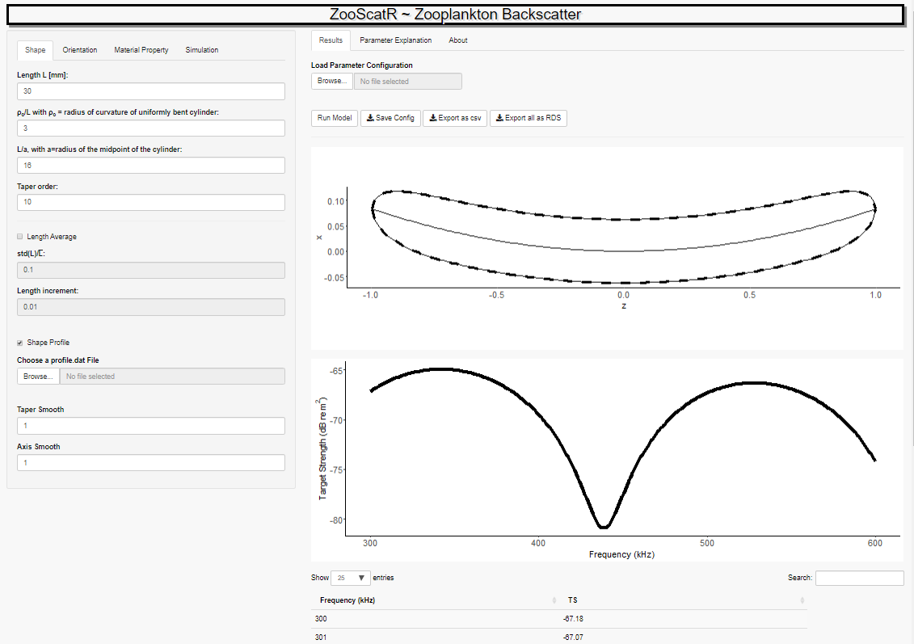
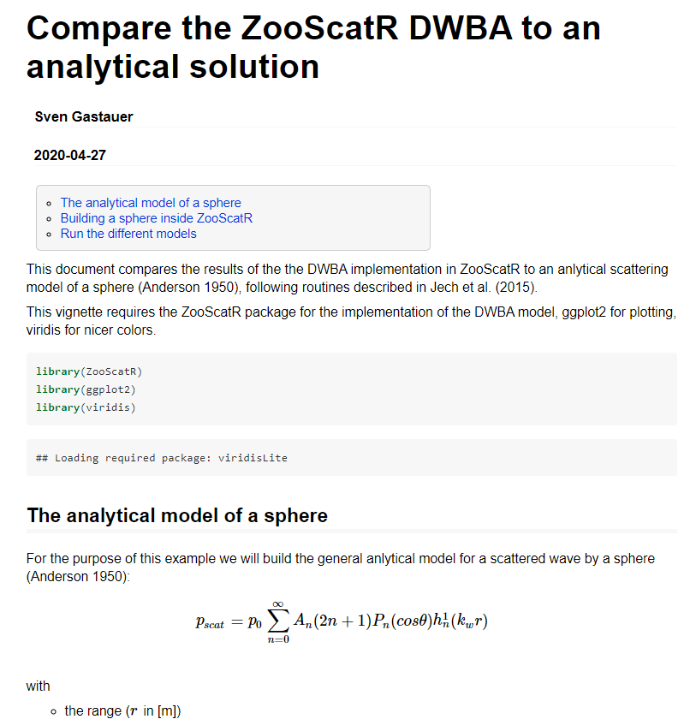
Using ZooScatR – the easy way
Installing the package
Run the shiny web app
Getting help through Vignettes or function descriptions

Slide 11
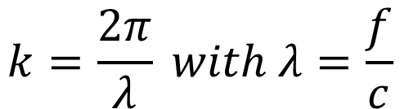
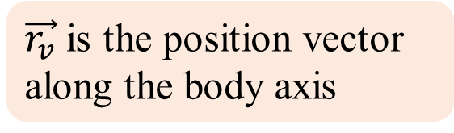
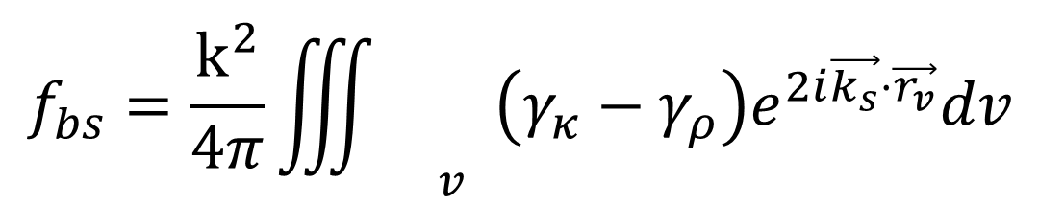
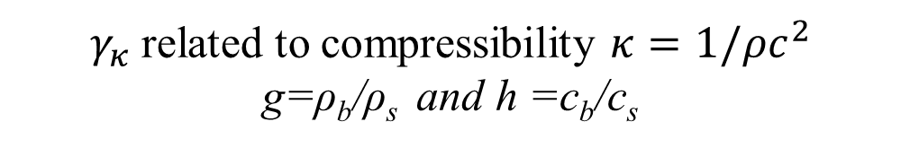
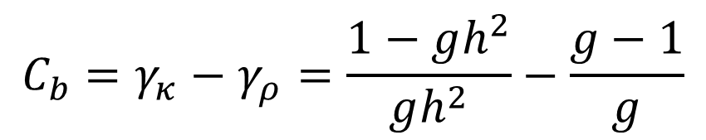
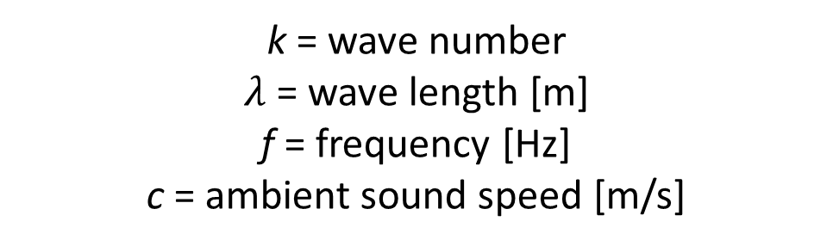
DWBA Model
v is the integration volume of the body
$$f_{bs}=\frac{k^{2}}{4π}{\iiint{}}_{v}^{}\left(γ_{κ}−γ_{ρ}\right)e^{2i\vec{k_{s}}⋅\vec{r_{v}}}dv$$
Phase Term
Frequency and ambient sound speed dependence
$\vec{r_{v}}$ is the position vector along the body axis
$$k=\frac{2π}{λ} with λ=\frac{f}{c}$$
Body properties/condition
k = wave number
$λ$ = wave length [m]
f = frequency [Hz]
c = ambient sound speed [m/s]
$$C_{b}=γ_{κ}−γ_{ρ}=\frac{1−gh^{2}}{gh^{2}}−\frac{g−1}{g}$$
$γ_{κ}$related to compressibility $κ=1/ρc^{2}$
g=ρ_{b}/ρ_{s} and h =c_{b}/c_{s}

Slide 12
Live Demonstration ZooScatR….. Demonstrate the influence of g and h and size on spheres, prolate spheroids and krill

Slide 13
Get model input parameters

Slide 14
Shape demo

Slide 15
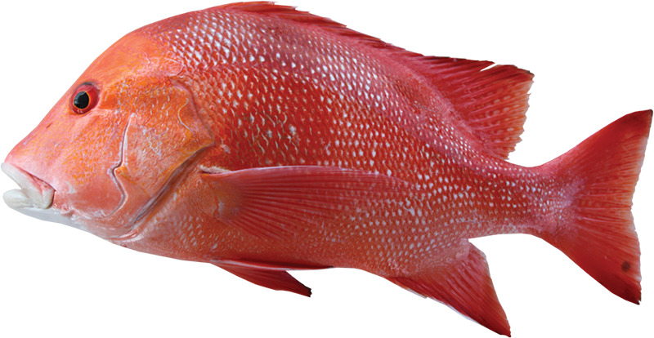
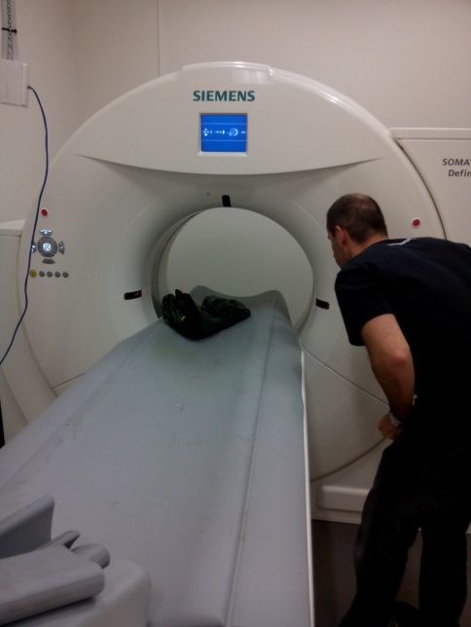

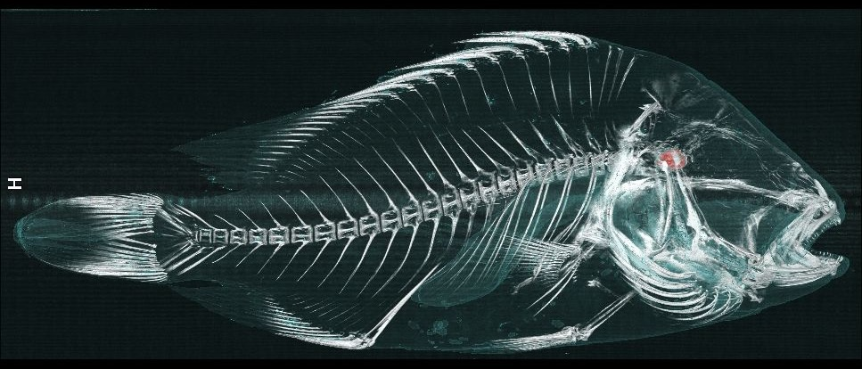
CT Scans for meshes

Slide 16
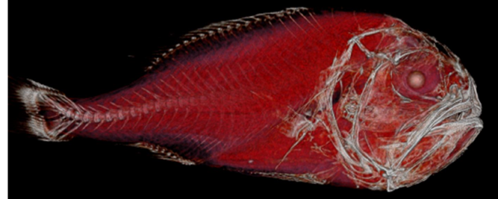
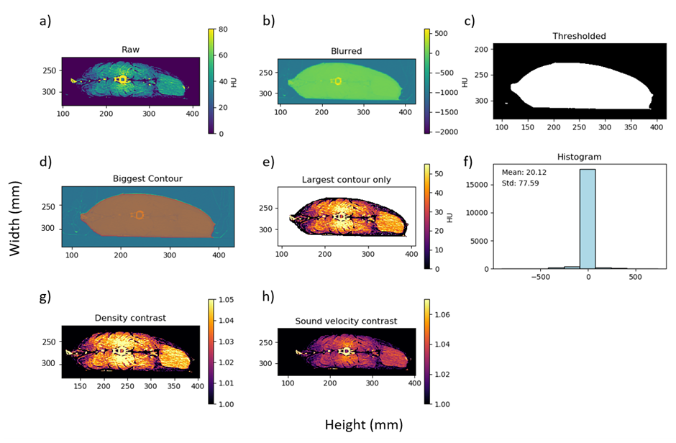
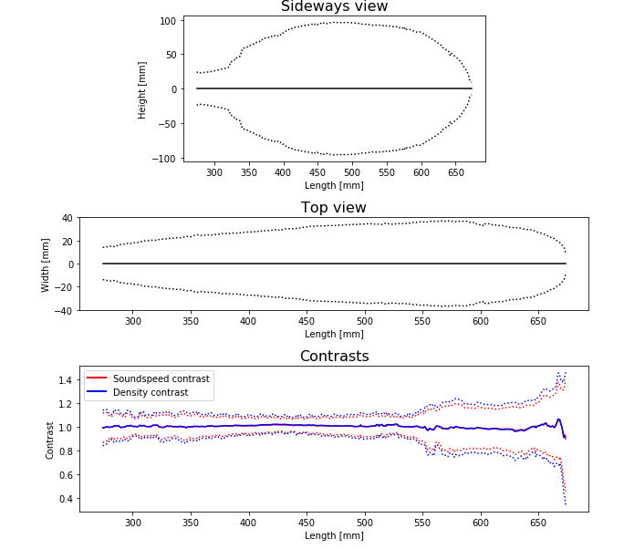
CT Scans for meshes

Slide 17
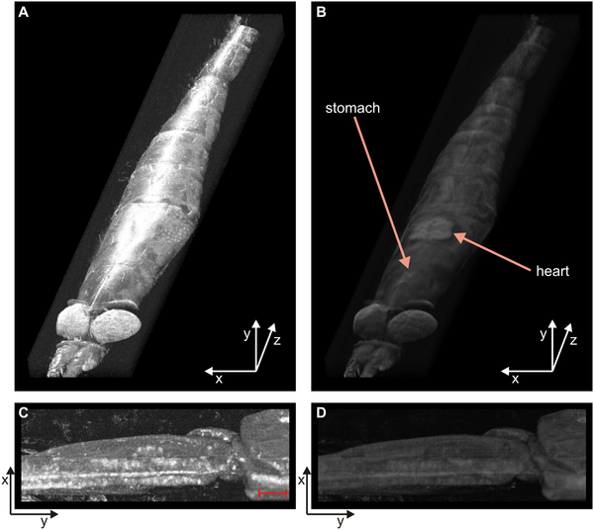
OCT
Bellini N, Cox MJ, Harper DJ, Stott SR, Ashok PC, et al. (2014) The Application of Optical Coherence Tomography to Image Subsurface Tissue Structure of Antarctic Krill Euphausia superba. PLOS ONE 9(10): e110367. https://doi.org/10.1371/journal.pone.0110367
https://journals.plos.org/plosone/article?id=10.1371/journal.pone.0110367

Slide 18
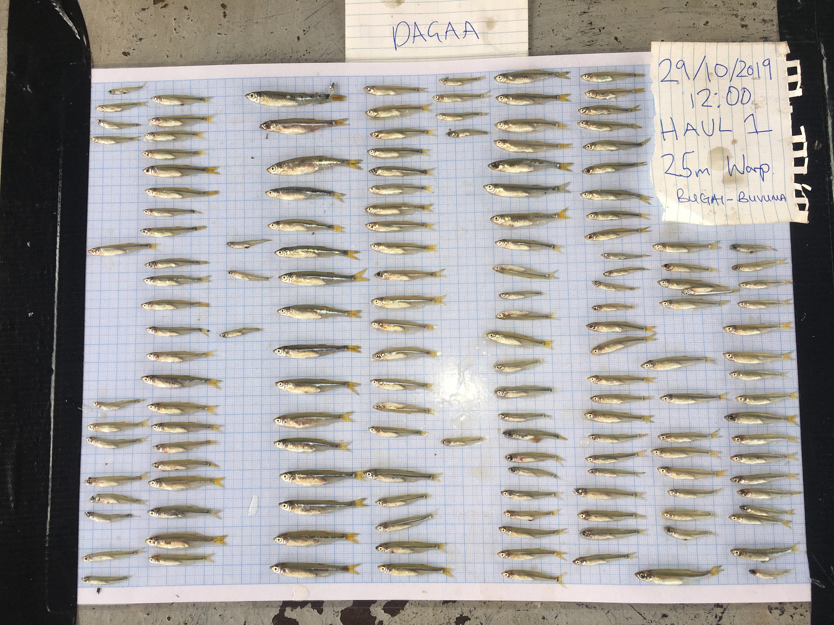
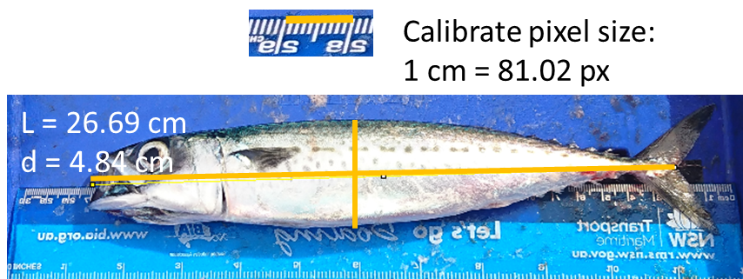
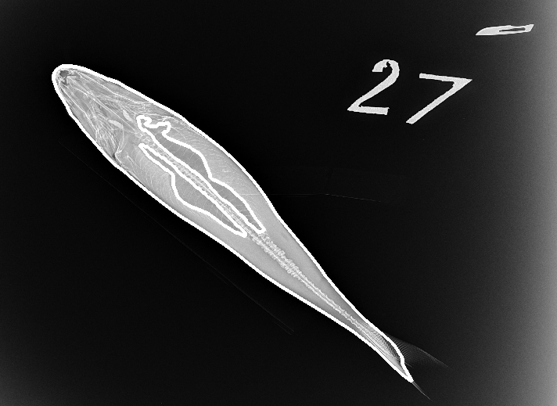
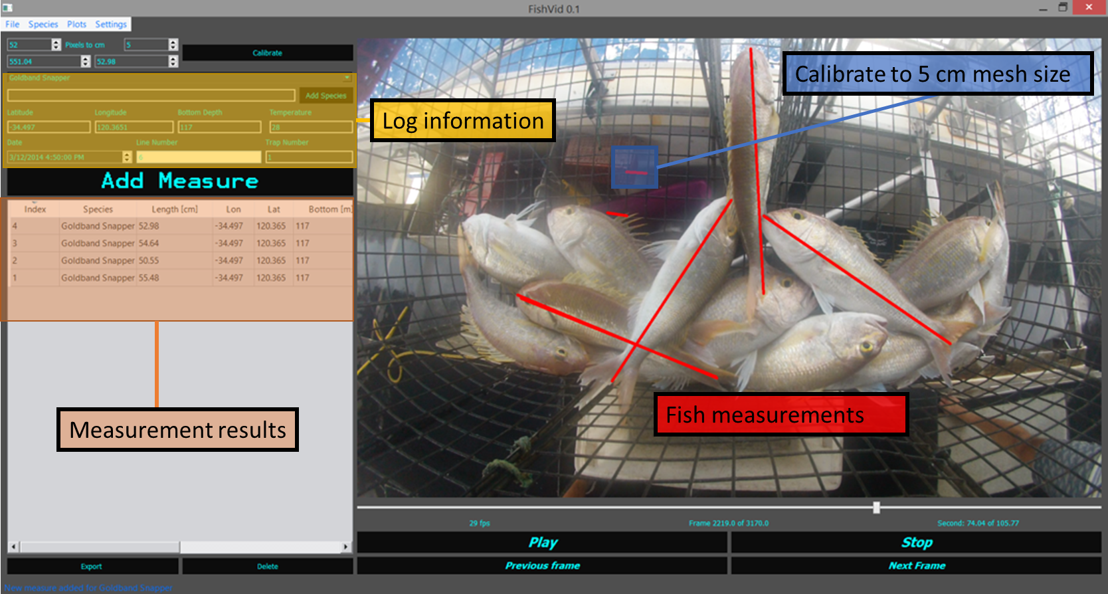
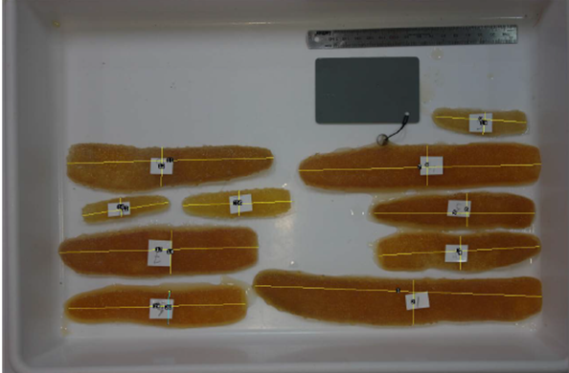
Camera or photo recordings
Contours from X-Rays

Slide 19
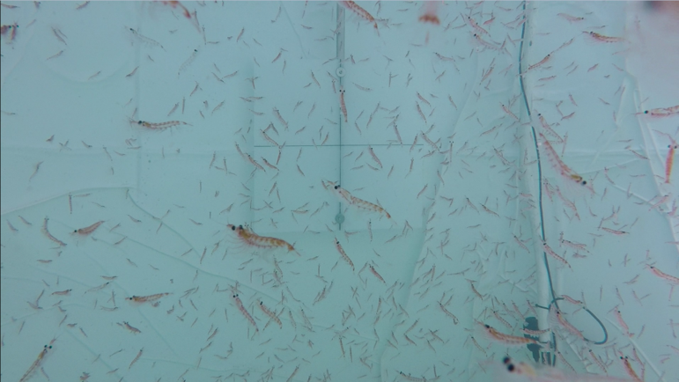
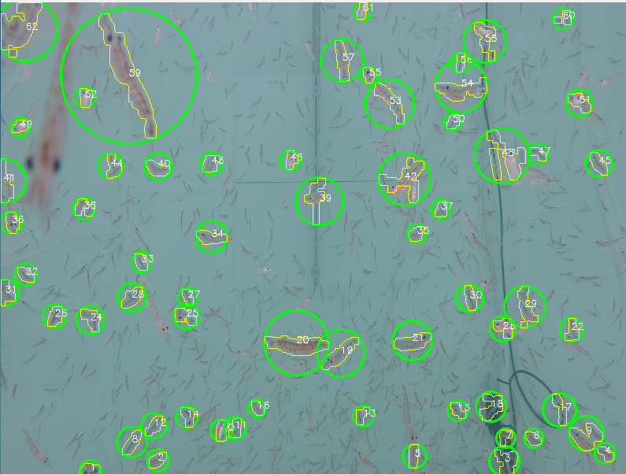
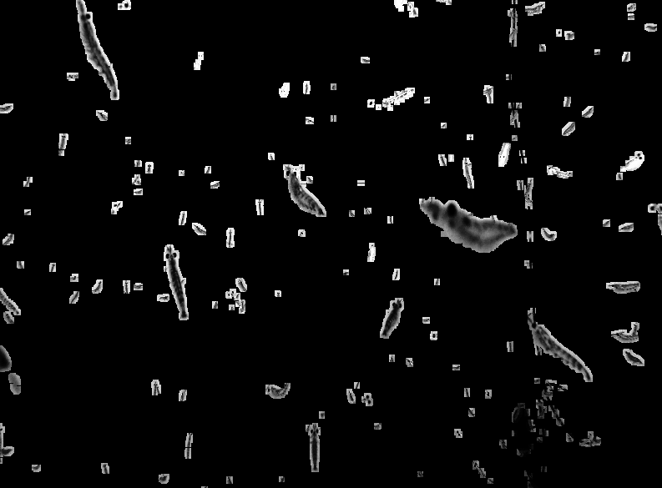
Stereo camera recordings
Blob and contours detected
Background removed, smoothed,...

Slide 20
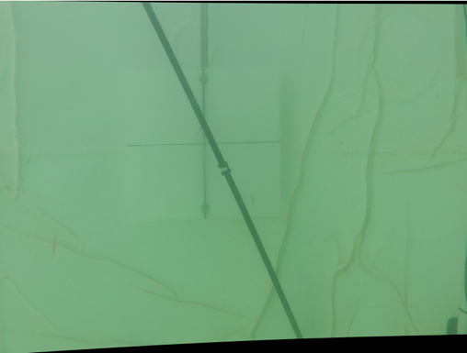
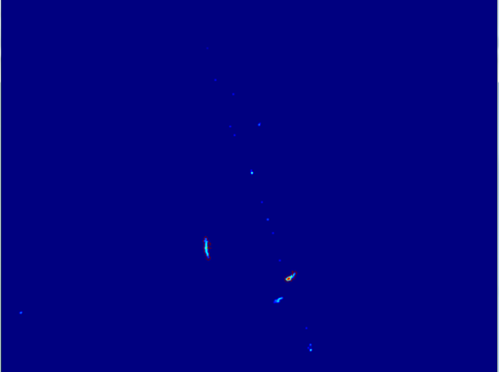
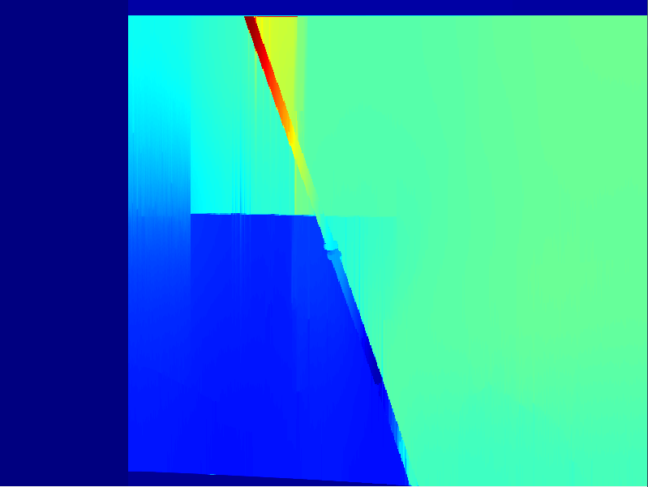
Original recording
Background removed and filtered
Combined Disparity map
Right frame
Right frame
Model output
2D projection
Tapering
Z-axis
Shape for model
Y-axis

Slide 21
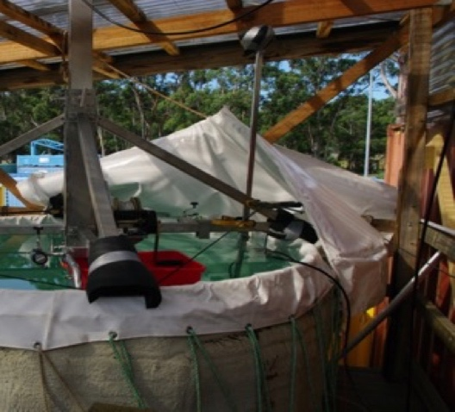
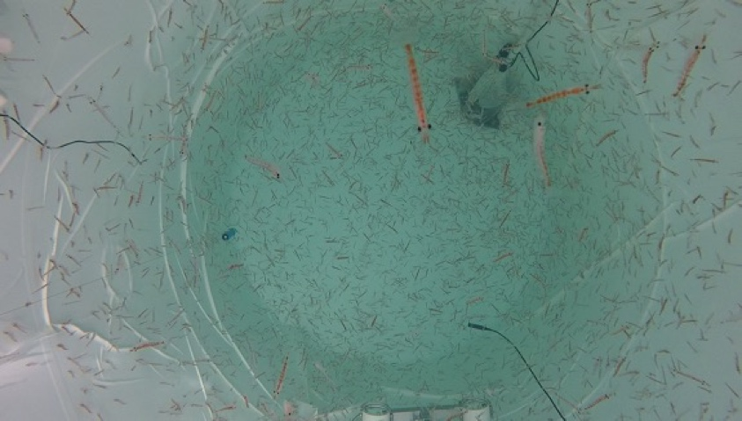







Slide 22
Size / g&h demo

Slide 23




Measuring density and sound speed contrast
g = density contrast | h = sound speed contrast

Slide 24




Acoustic subsystem
Pulser
Holes (let water enter)
Pulse generations
Seawater
Animal compartment
Receiver (transducer 2)
Transmitter (transducer 1)
Amplification
Computer
Oscilloscope
Pulser/Receiver
Data reception

Slide 25




Density measurements
2 fluid solution to get the density contrast
Measuring the densities of the fluids separately and combined
Measuring the weight of the compartment with and without animals and liquids
-> Resolve equations to get density contrast h

Slide 26









Krill survey 2019
Synoptic krill survey 2019:
7 vessels covering total of over 15,822 nm
Trained personnel aboard:
4,562 nm by Norwegian vessel
1,119.9 nm Chinese FV
1059.7 nm by Aker

Slide 27
Sizing targets

Slide 28





Scattering by a fluid-like sphere
$$d_{a}=\frac{c_{w}}{2 Δf}$$
$$L_{a}=\frac{d_{a}}{2} ∗ \overline{\frac{L_{m}}{\overline{a_{m}}}}$$
TS at different sizes with varying g and h
Target detection at accuracy at different Signal to Noise Ratios
Good results for a signal to Noise ratio ~0
Size dependent periodicity, condition dependent amplitude

Slide 29




 | Measured |  |  | Acoustics
ID | Length | Width | L/a | N | Δf | sd Δf | Width | sd Width
1.0 | 23.1 | 4.3 | 10.7 | 25.0 | 18.7 | 0.16 | 4.1 | 0.04
2.0 | 22.0 | 4.0 | 11.0 | 38.0 | 18.6 | 0.15 | 4.1 | 0.03
3.0 | 23.1 | 4.1 | 11.3 | 42.0 | 18.6 | 0.13 | 4.1 | 0.03
4.0 | 24.6 | 4.2 | 11.8 | 43.0 | 19.1 | 1.42 | 4.2 | 0.25

Slide 30


Scattering by rotated prolate spheroids
0°
30°
60°
$$f_{corr}=\frac{1}{\sqrt{\left(e_{yx}^{2}\sin^{2}{θ_{s}+cos^{2}{θ_{s}}}\right)} }$$
90°

Slide 31




In situ measurements – getting height of the fish

Slide 32


In situ measurements – getting orientation of the fish
Echoview track direction
(Vertical direction first to last point in track)
Tilt angle derived from broadband data

Slide 33











Conclusion and outlook
Scattering models are not reality
Scattering models can help us to improve our understanding of the complex reality
Scattering models look scary at first but can be used by a broad audience with some background knowledge
ICES WGFAST will host a workshop next year to work on opensource, easy to use, standardized scattering models

Slide 34

















Thank You!

